Slide 1

Clustering & Topic Modeling
Applied Text Mining, from Foundations to Advanced
Robert Bagheri
2026
Notes:
Video by Google DeepMind from Pexels: https://www.pexels.com/video/an-artist-s-animation-of-artificial-intelligence-ai-this-video-depicts-language-models-which-generate-text-it-was-created-by-wes-cockx-as-part-of-the-visualising-ai-project-launched-by-18069700/

Slide 2
This lecture
Text clustering
Topic modeling
Evaluation

Slide 3
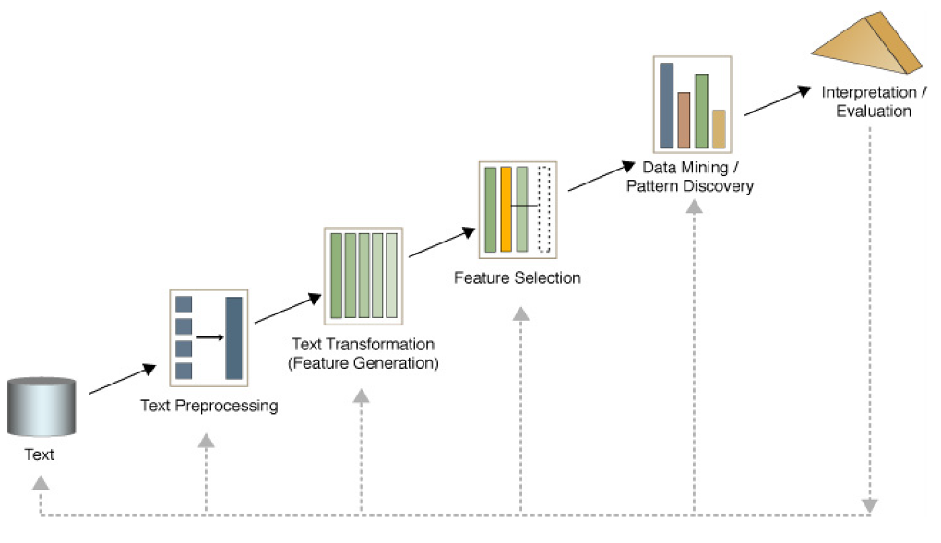
Text mining process

Slide 4
Text Clustering

Slide 5
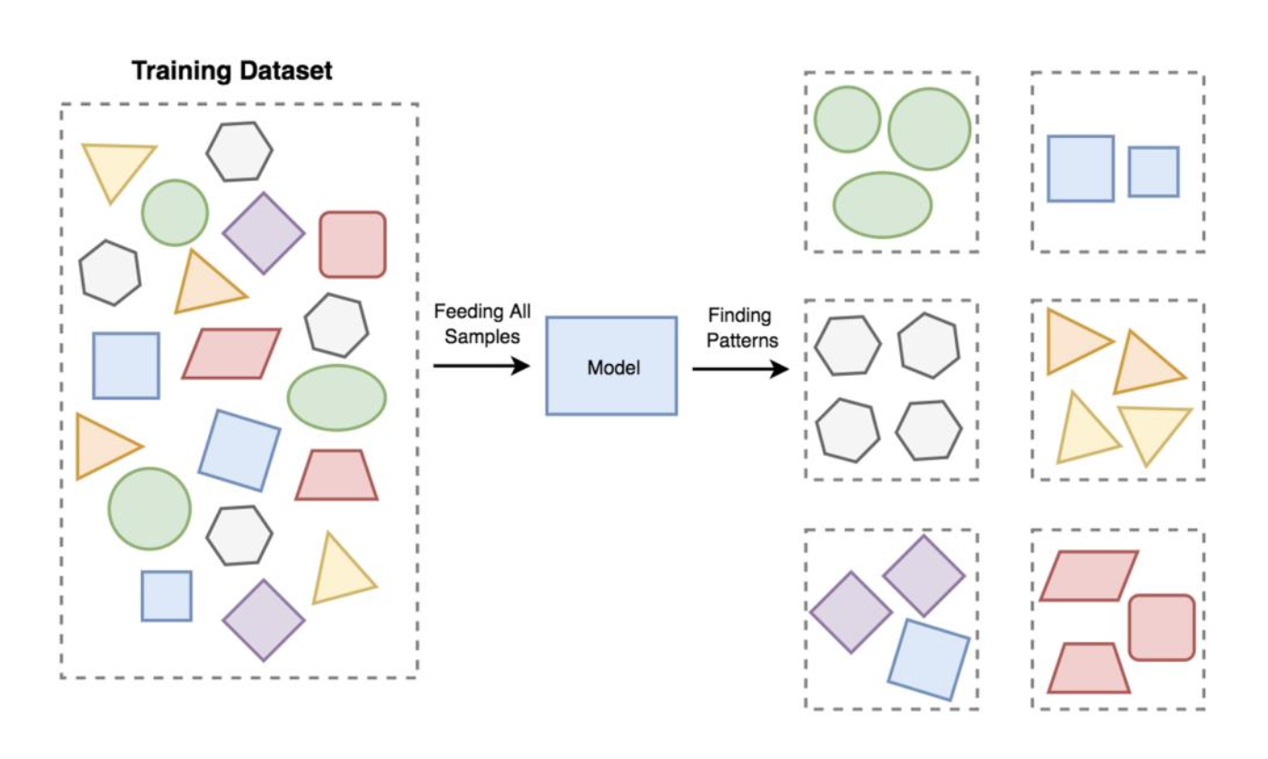
Unsupervised learning

Slide 6
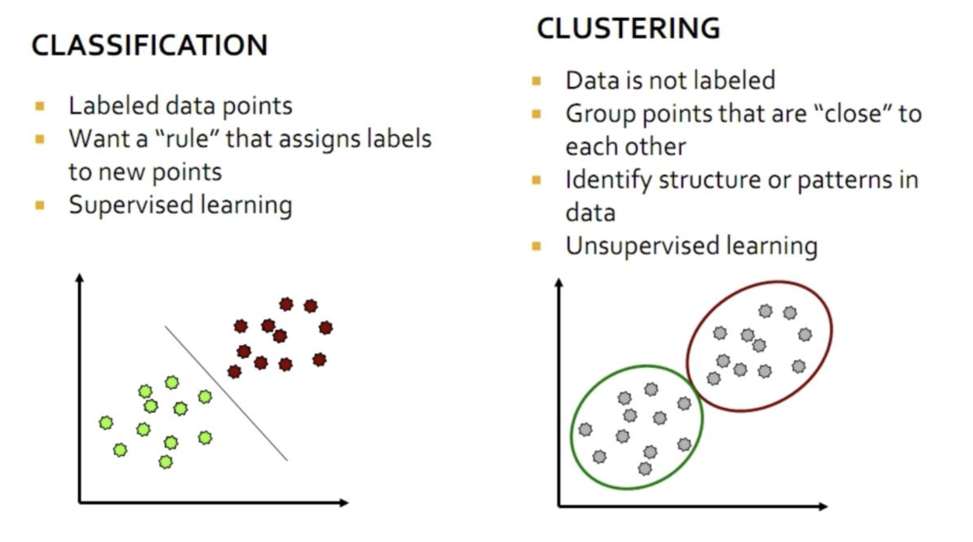
Clustering vs Classification

Slide 7
Clustering
Find subgroups (clusters) of similar examples in a dataset.

Slide 8
Clustering
Clustering: the process of grouping a set of objects into clusters of similar objects
Discover “natural structure” of data
What is the criterion?
How to identify them?
How to evaluate the results?
Soft vs Hard Clustering

Slide 9
Hierarchical clustering

Slide 10
Hierarchical clustering
Bottom-up agglomerative clustering
For each observation, compute the distance to all other observations
Assign all examples to their individual cluster
Combine most similar cluster
Keep combining clusters until there is only one cluster left
Select number of clusters for the final solution
Divisive: start with one and keep splitting most different

Slide 11
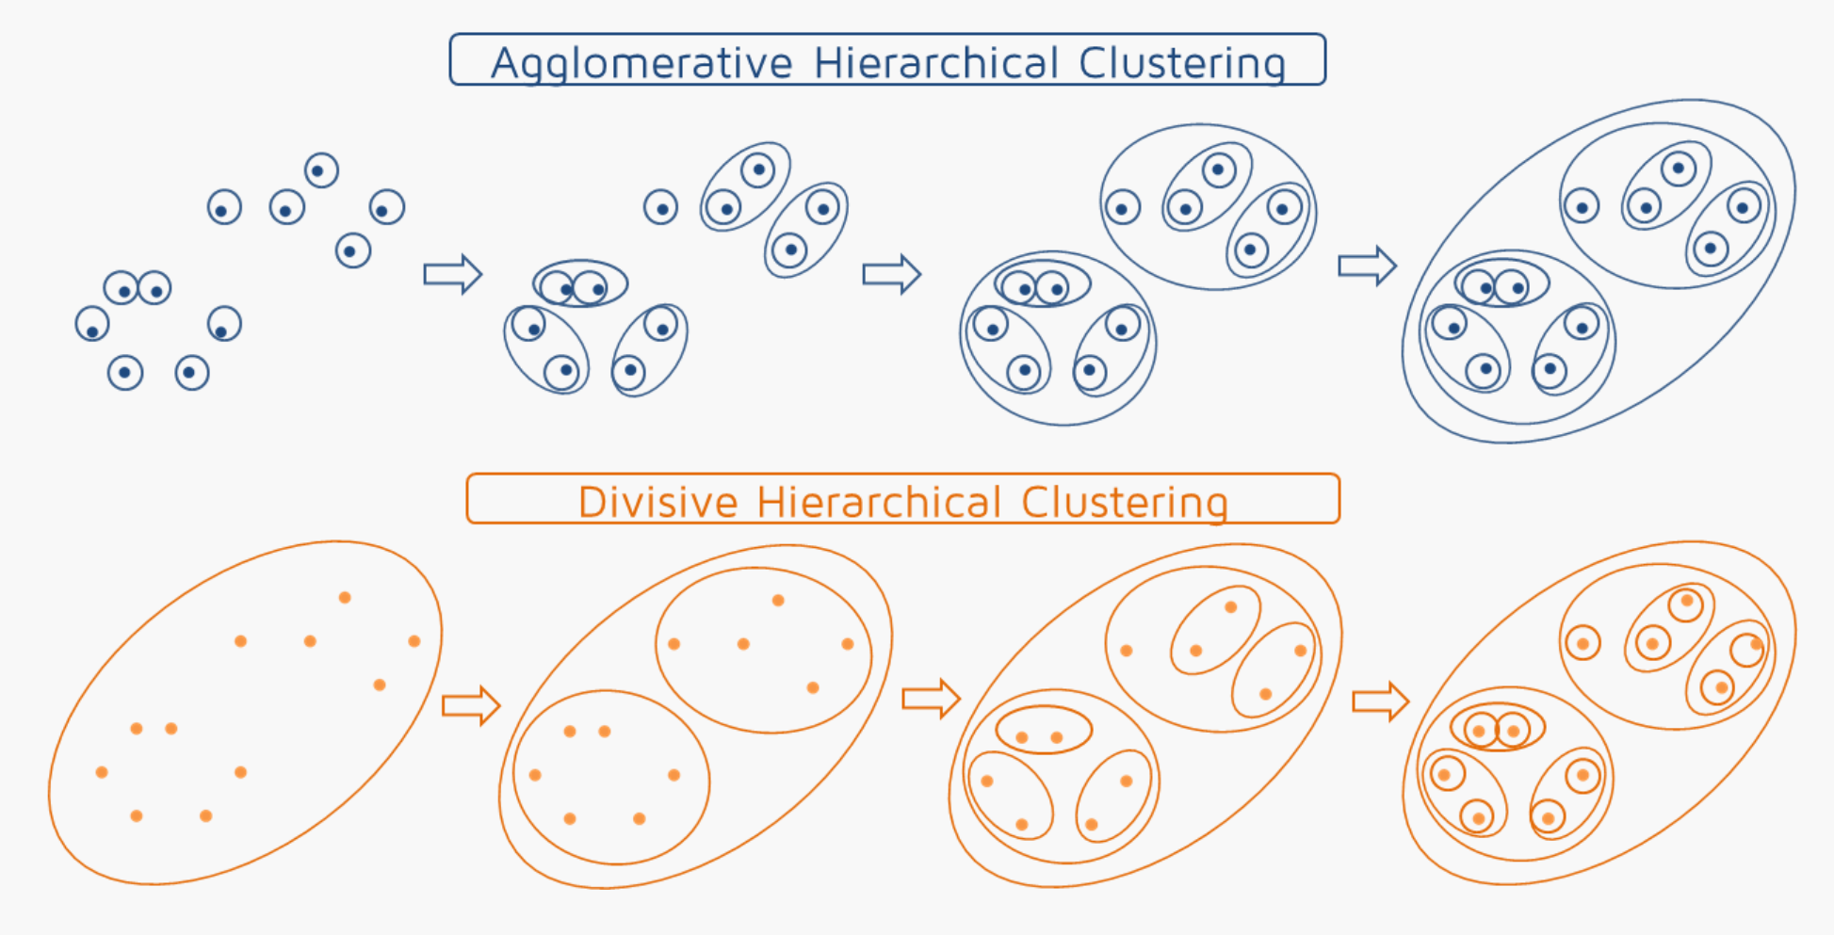
https://quantdare.com/hierarchical-clustering/
Notes:
11

Slide 12
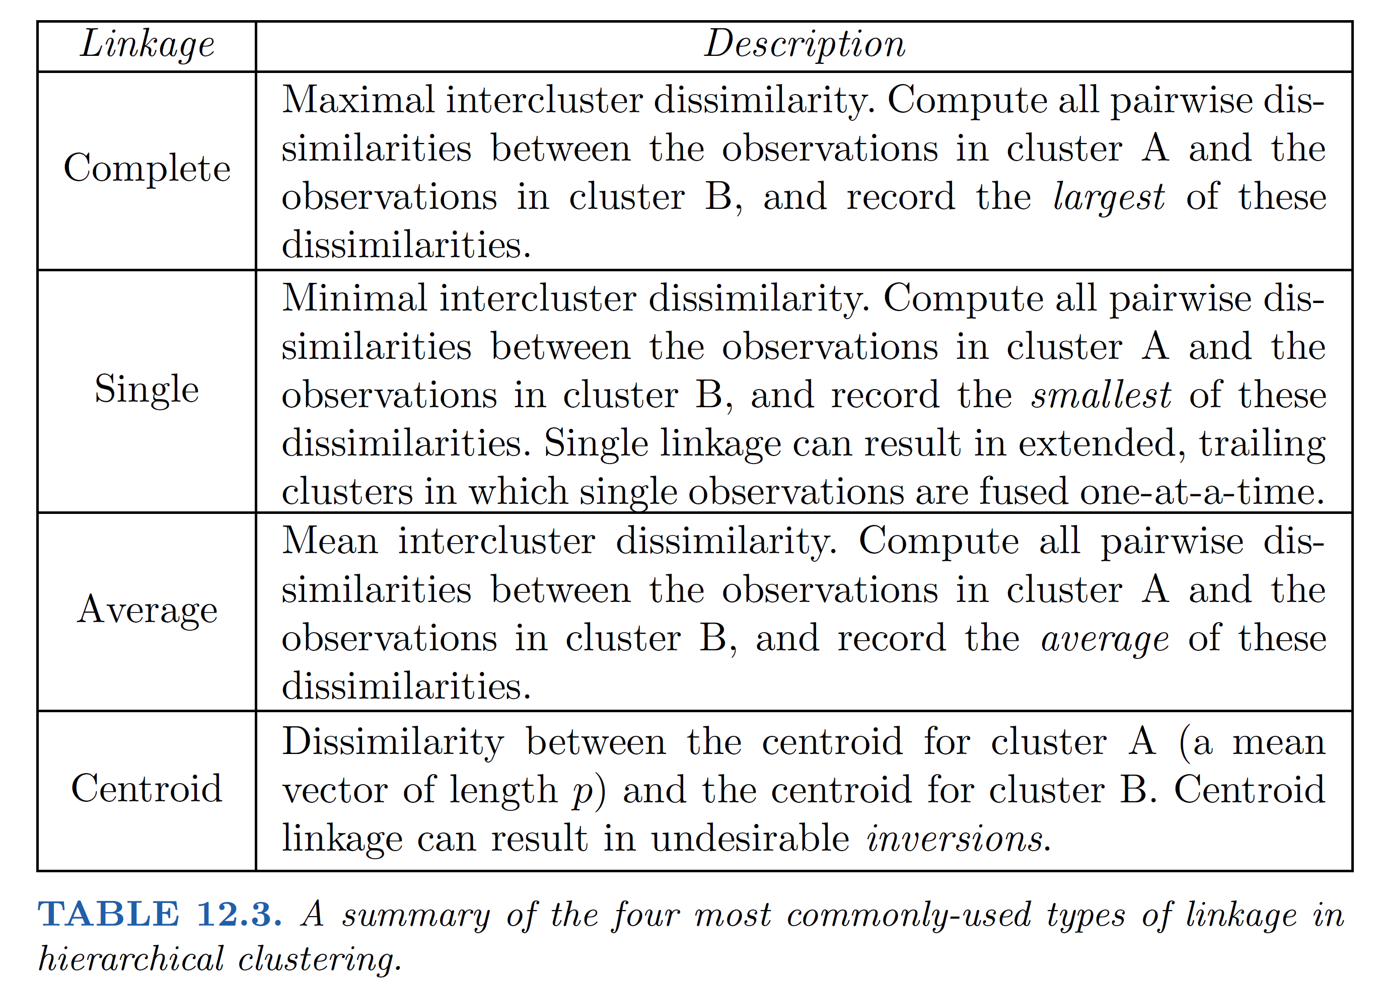

Slide 13
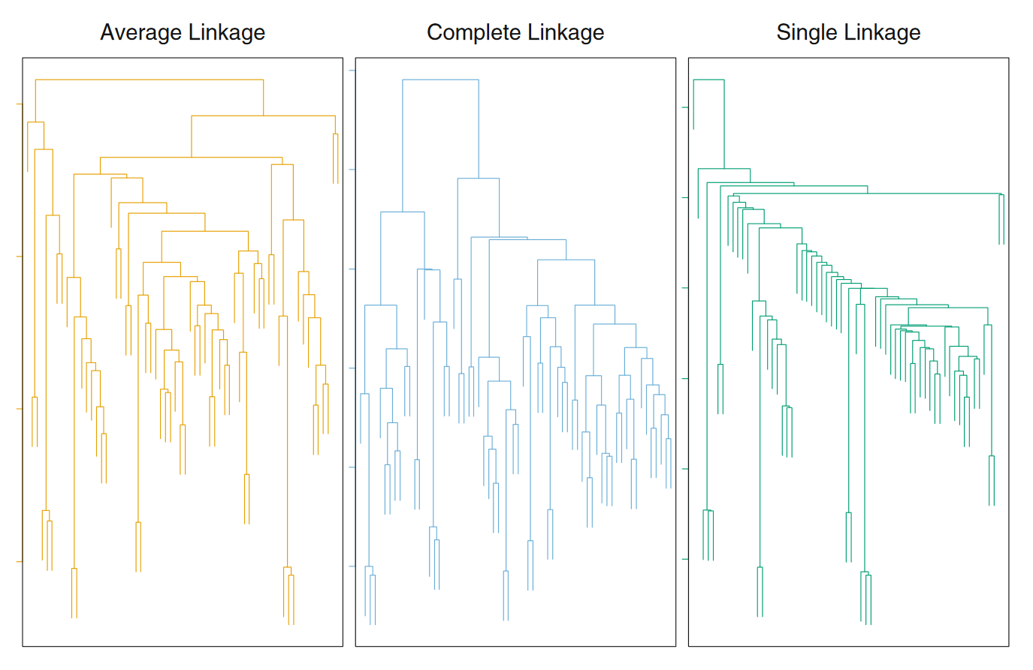

Slide 14
K-means clustering

Slide 15
K-means clustering
Predefine the number of clusters (K)
Apply an algorithm to assign observations to clusters
Top-down method

Slide 16
K-means clustering algorithm
1. Randomly assign examples to 𝐾 clusters
2a. Calculate the centroid (per-feature mean) for each cluster
2b. Assign each example to the cluster belonging to its closest centroid
3. If the assignments changed, go to step 2a, else stop

Slide 17
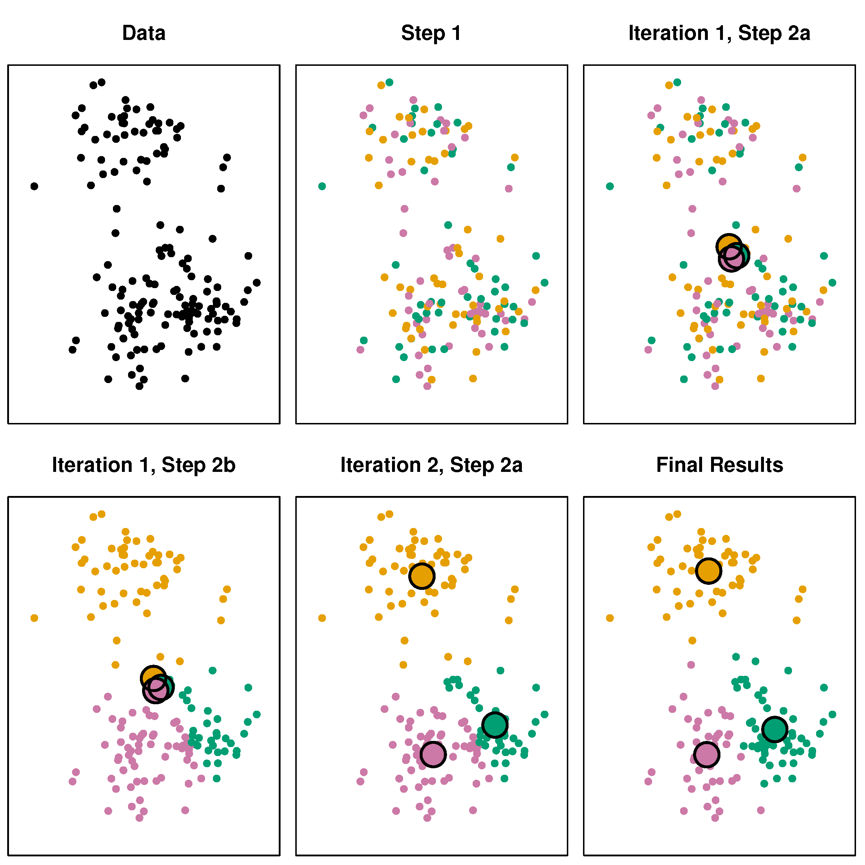
K-means clustering
ISLR2 fig 12.8

Slide 18
K-means clustering
K and the distance metric are hyperparameters
Distance metric can be anything, just like in hierarchical clustering
Determined by the structure / content of the data
Usually euclidian distance
K is determined in advance by the data scientist based on knowledge about the data or the goal of the analysis
Perhaps there are generally 2 types of geyser eruption because of physics
We may have resources to approach customers in at most 3 different ways

Slide 19
K-means clustering
Because the initialization is random, the result is random
Label switching: cluster 1, 2, 3 may end up in each other’s locations
Some examples at the boundary may end up in different clusters altogether
Use multiple starts to obtain the best solution

Slide 20
Evaluating cluster results

Slide 21
Evaluating cluster results
Many options (hyperparameters) in clustering methods
They need to be tuned to obtain “good” clusters.
“small decisions with big consequences” (ISLR2, section 12.4.3)
In other words: clusters are sensitive to hyperparameter choice
Three methods to assess whether obtained clusters are “good”
Stability
External validity
Internal validity

Slide 22
Cluster stability
How stable are the clusters?
Two different ways
Bootstrap stability
Compute cluster solutions on M bootstrap samples (Hennig, 2007)
Compare the similarity of the M cluster solutions to the original solution
More similar is better!
Leave-one-feature-out
Leave a feature out and perform clustering
Compare the similarity of the cluster solutions to the original solution
More similar is better!

Slide 23
External validity
Are the clusters associated with external feature 𝑌?
Making unsupervised supervised (a little cheating)
Examples:
Are my customer segments based on spending associated with the demographics of the customers?
Are the geyser eruption types strongly correlated with water pressure or temperature?
Can I recognize the person in the vector quantized picture?

Slide 24
Internal validity
Use measure to calculate how close are documents in a cluster and how distant are documents in different clusters
Coherence
Inter-cluster similarity v.s. intra-cluster similarity
Davies–Bouldin index
where 𝑘 is total number of clusters, 𝜎_{𝑖} is average distance of all elements in cluster 𝑖 from the cluster center, 𝑑(𝑐_{𝑖},𝑐_{𝑗}) is the distance between cluster centroid 𝑐_{𝑖} and 𝑐_{𝑗}.
We prefer smaller DB-index!

Slide 25
Validation in sklearn
https://scikit-learn.org/stable/modules/clustering.html#clustering-performance-evaluation
Rand index
Mutual Information based scores
Homogeneity, completeness and V-measure
Fowlkes-Mallows scores
Silhouette Coefficient
Calinski-Harabasz Index
Davies-Bouldin Index
Contingency Matrix
Pair Confusion Matrix

Slide 26
Break

Slide 27
Topic Modeling

Slide 28
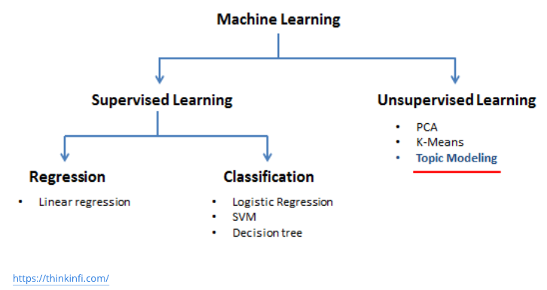
Topic modeling

Slide 29
What is a Topic?
A probabilistic distribution over words
A broad concept/theme, semantically coherent, which is hidden in documents
e.g., politics; sports; technology; entertainment; education etc.

Slide 30
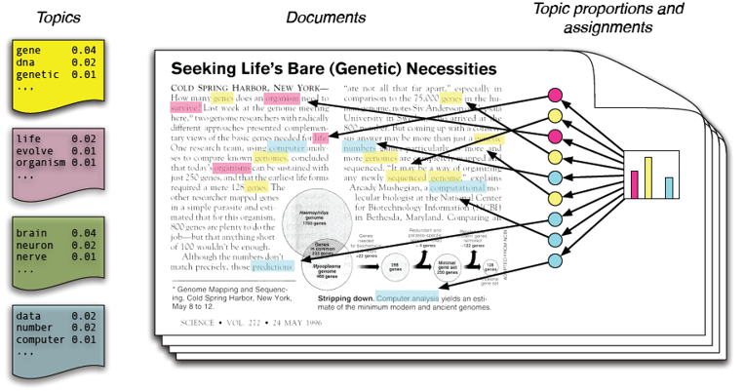
The goal
Blei, D. M., Ng, A. Y., & Jordan, M. I. (2003). Latent Dirichlet allocation. the Journal of machine Learning research, 3, 993-1022.
https://dl.acm.org/doi/pdf/10.5555/944919.944937

Slide 31
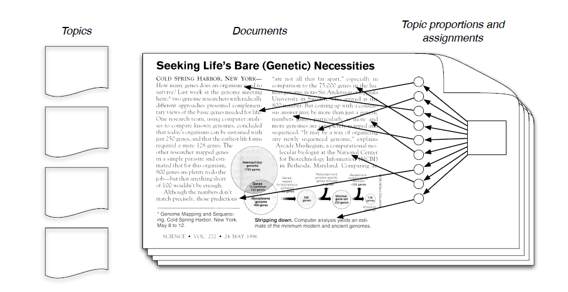
Reality

Slide 32
Document as a mixture of topics
[ Criticism of government response to the hurricane primarily consisted of criticism of its response to the approach of the storm and its aftermath, specifically in the delayed response ] to the [ flooding of New Orleans. … 80% of the 1.3 million residents of the greater New Orleans metropolitan area evacuated ] …[ Over seventy countries pledged monetary donations or other assistance]. …
government 0.3 response 0.2 ...
Topic θ₁
city 0.2 new 0.1 orleans 0.05 ...
Topic θ₂
…
How can we discover these topic-word distributions?
donate 0.1 relief 0.05 help 0.02 ...
Topic θ_{m}
is 0.05 the 0.04 a 0.03 ...
General θ_{k}

Slide 33
General idea of topic models
Topic: a multinomial distribution over words
Document: a mixture of topics
A document is “generated” by first sampling topics from some prior distribution
Each time, sample a word from a corresponding topic
Many variations of how these topics are mixed
Topic modeling
Fitting the probabilistic model to text
Answer topic-related questions by computing various kinds of posterior distributions
e.g., p(topic|time), p(sentiment|topic)

Slide 34
Applications
Dimensionality reduction / Summarizing topics
Clustering / classification
Predict topic coverage for documents / Model the topic correlations
Many other text mining tasks

Slide 35
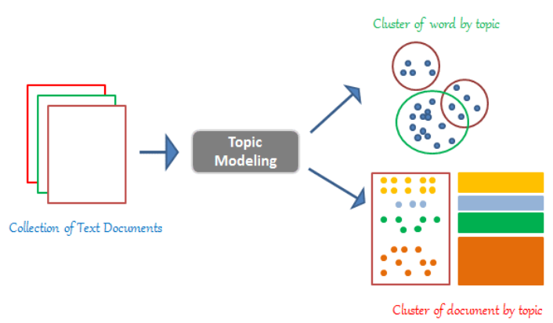
Topic modeling

Slide 36
Latent Dirichlet Allocation
LDA is most used topic modeling method.
LDA follows the basic principles of topic modeling.
In LDA:
Documents are represented as a mixture of topics,
And a topic is a bunch of words.
Those topics reside within a hidden, also known as a latent layer.

Slide 37
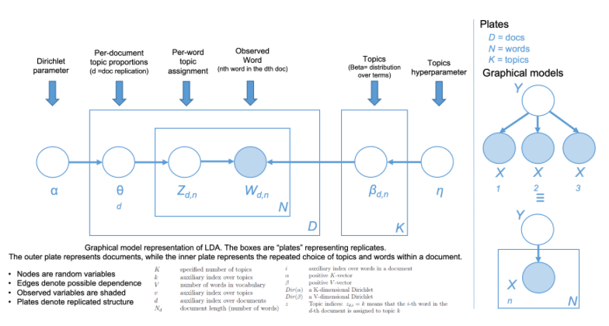
LDA graphical model

Slide 38
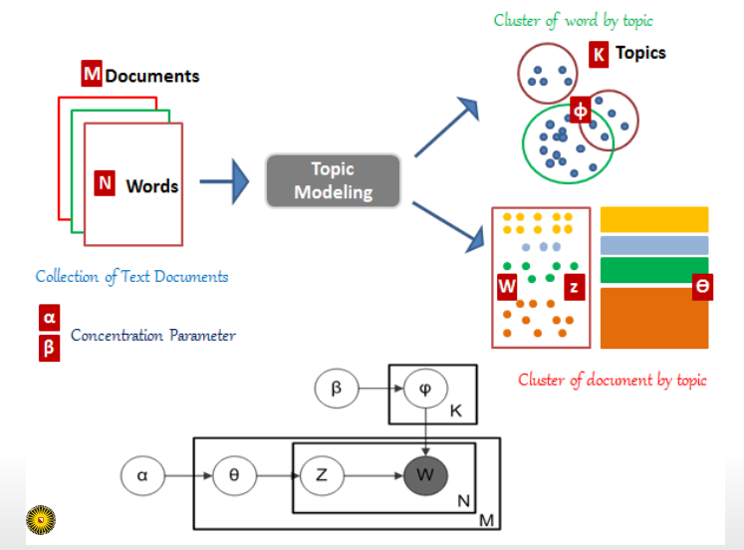
LDA graphical model Explained!

Slide 39
Probabilistic modeling
Treat data as observations that arise from a generative probabilistic process that includes hidden variables: For documents, the hidden variables reflect the thematic structure of the collection.
Infer the hidden structure using posterior inference: What are the topics that describe this collection?
Situate new data into the estimated model: How does this query or new document fit into the estimated topic structure?

Slide 40
LDA example
What is latent Dirichlet allocation? It’s a way of automatically discovering topics that these sentences contain.
Suppose you have the following set of sentences:
I like to eat broccoli and bananas.
I ate a banana and spinach smoothie for breakfast.
Chinchillas and kittens are cute.
My sister adopted a kitten yesterday.
Look at this cute hamster munching on a piece of broccoli.

Slide 41
LDA example
Given these sentences and asked for 2 topics, LDA might produce something like:
Sentences 1 and 2: 100% Topic A
Sentences 3 and 4: 100% Topic B
Sentence 5: 60% Topic A, 40% Topic B
Topic A: 30% broccoli, 15% bananas, 10% breakfast, 10% munching, … (at which point, you could interpret topic A to be about food)
Topic B: 20% chinchillas, 20% kittens, 20% cute, 15% hamster, … (at which point, you could interpret topic B to be about cute animals)
How does LDA perform this discovery?

Slide 42
LDA training
Go through each document, and randomly assign each word in the document to one of the K topics.
Notice that this random assignment already gives you both topic representations of all the documents and word distributions of all the topics (albeit not very good ones).
So to improve on them, for each document d…
Go through each word w in d…

Slide 43
LDA training
And for each topic t, compute two things:
p(topic t | document d) = the proportion of words in document d that are currently assigned to topic t, and
p(word w | topic t) = the proportion of assignments to topic t over all documents that come from this word w.
Reassign w a new topic, where we choose topic t with probability p(topic t | document d) * p(word w | topic t)
In other words, in this step, we’re assuming that all topic assignments except for the current word in question are correct, and then updating the assignment of the current word using our model of how documents are generated.

Slide 44
LDA training
After repeating the previous step a large number of times, you’ll eventually reach a roughly steady state where your assignments are pretty good.
Use these assignments to estimate the topic mixtures of each document (by counting the proportion of words assigned to each topic within that document) and the words associated to each topic (by counting the proportion of words assigned to each topic overall).

Slide 45
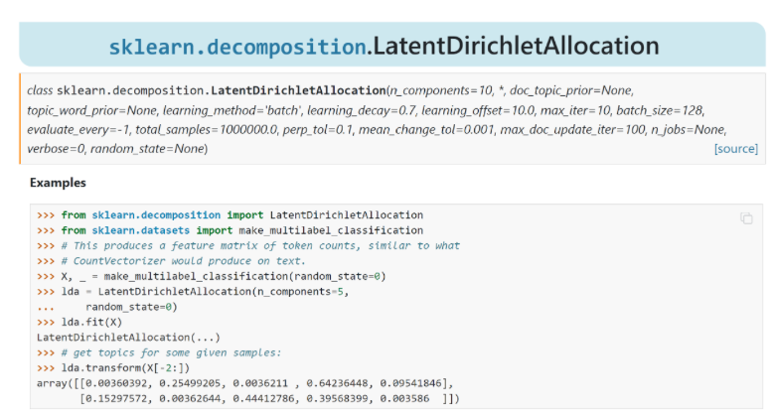
LDA in Python

Slide 46
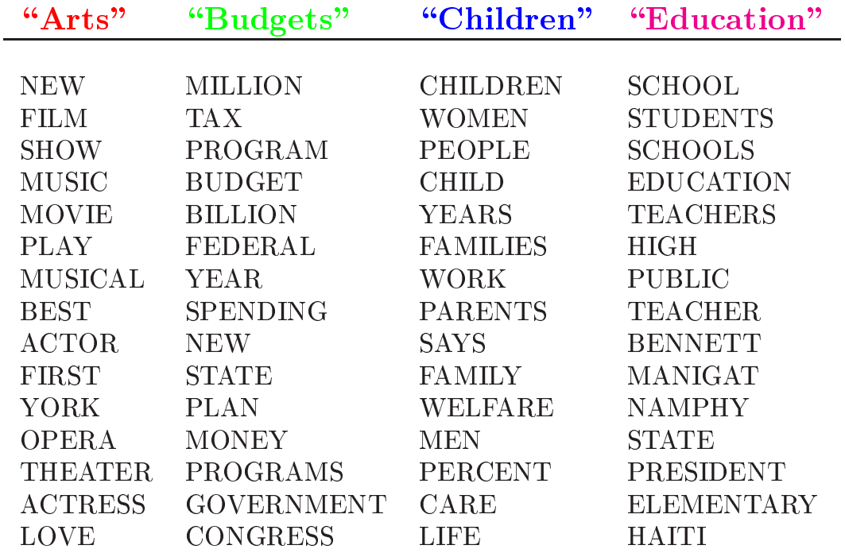
Topics learned by LDA AP corpus

Slide 47
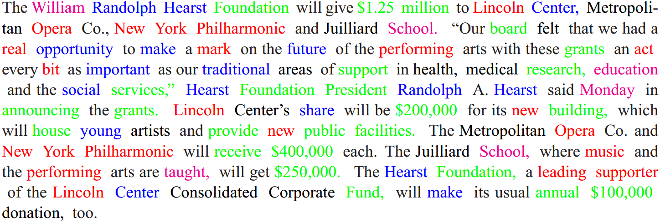
Topic assignments AP corpus

Slide 48
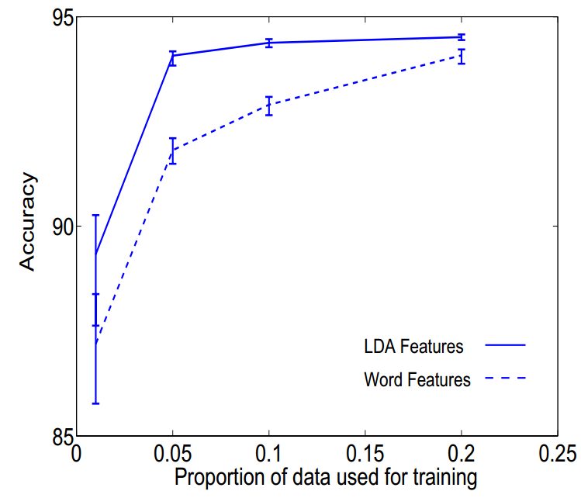
Application of learned topics
Document classification
A new type of feature representation

Slide 49
Variants of topic models
Smoothed LDA
Correlated Topic Models
Hierarchical Topic Models
Dynamic Topic Models
Contextual Topic Models
BERTtopic: https://github.com/MaartenGr/BERTopic
And many more!

Slide 50
Conclusion
Text clustering & topic modelling
In clustering, clusters are inferred from the data without human input (unsupervised learning)
Many ways of influencing the outcome of clustering: number of clusters, similarity measure, representation of documents
Evaluation is important!

Slide 51
Practical 4

Slide 52
Questions?

